Slide 1
Marketing Administration

Slide 2
Session Objective
At the end of this session participants will be able to:
Define Leads and Campaigns
Create Campaign and Campaign Heirarchy
Add, Edit and Create Campaign Member
Define Web-to-Lead
Import Leads
Convert Leads
AutoResponse Rules
Campaign Reports

Slide 3
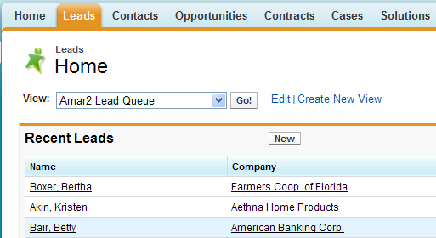
Leads
A lead is a prospect or potential opportunity. A person you met at a conference who expressed interest in your product and / or Service
Leads can be entered manually or administrator can import leads or set up Web-to-Lead to gather information from company’s website

Slide 4
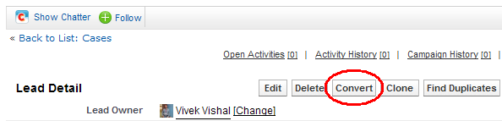
Leads
Clicking Convert button will convert the selected lead into an account, opportunity, and contact
The Clone button on a lead quickly creates a new lead with the same information as the existing lead
Administrator can create a lead assignment rule to automatically assign leads to different users or queues

Slide 5
Leads
Creating Leads: Leads can be added in Salesforce by one of the following methods
Manually by users
Imported using import wizard for leads
Captured via Web-to-Lead

Slide 6
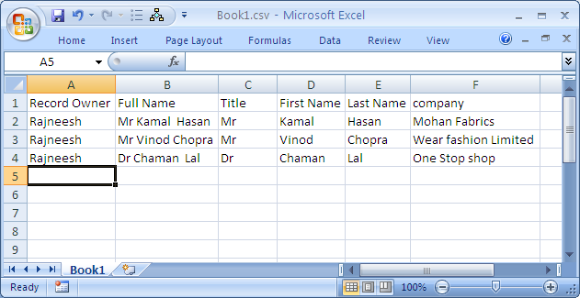
Leads – Import Wizard
Importing Leads using import wizard”
Identify the data file to be imported
The file must be in a ‘CSV’ format

Slide 7
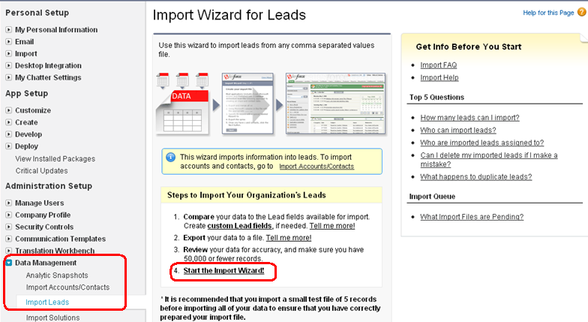
Leads – Import Wizard
To start Import Wizard, Select
Data Management → Import Leads → start import wizard

Slide 8
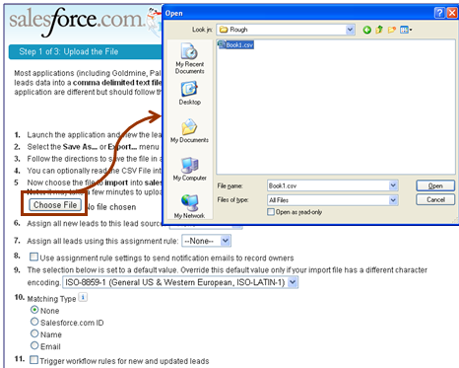
Leads – Import Wizard
Choose the data file to be imported as Leads.
Enter other values and click on ‘Next’ button.

Slide 9
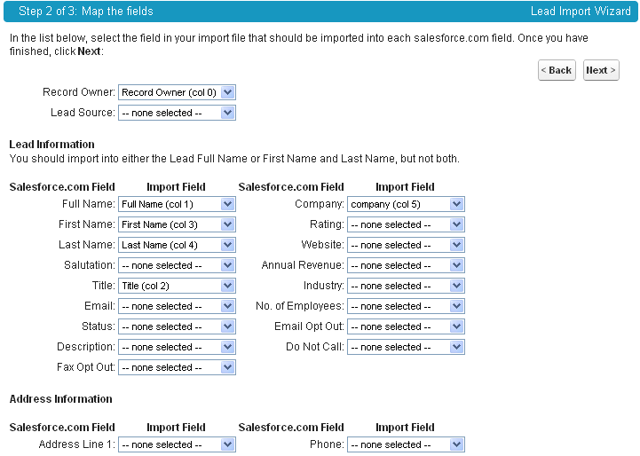
Leads – Import Wizard
Select the columns corresponding to the fields in CRM

Slide 10
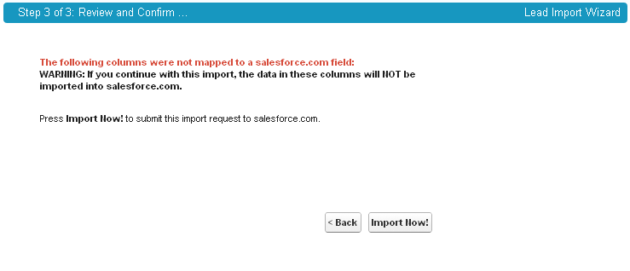
Leads – Import Wizard
Check the warning on non-Mapped fields
Click on ‘Import Now’ button to start importing process
Then click on “Finish” button in next step

Slide 11
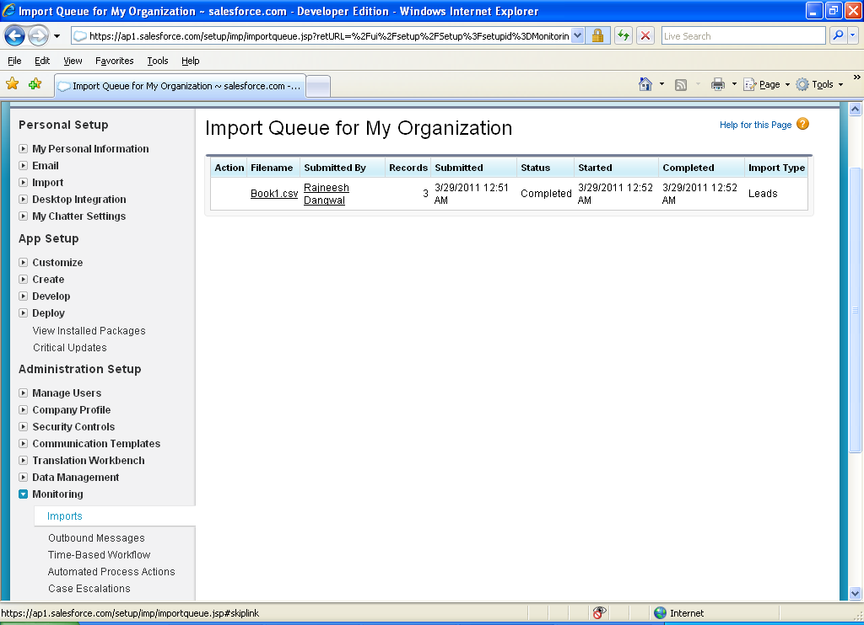
Leads – Import Wizard
Check the status of import by selecting
Administration Setup → Monitoring → Imports

Slide 12
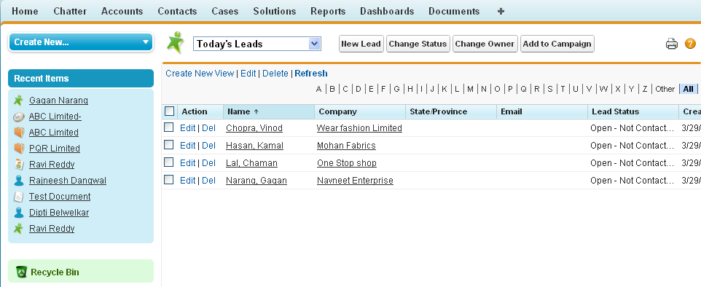
Leads – Import Wizard
Verify the imported data in the Leads Screen

Slide 13
Web-To-Lead
Online to capture lead information
Published on your website
All entries captured in Salesforce CRM
Auto-response rule determine which template to send
Email template
Std text or HTML
Enable stnd and consistent email message
Can be used with web-to-lead, WF , mail merge

Slide 14
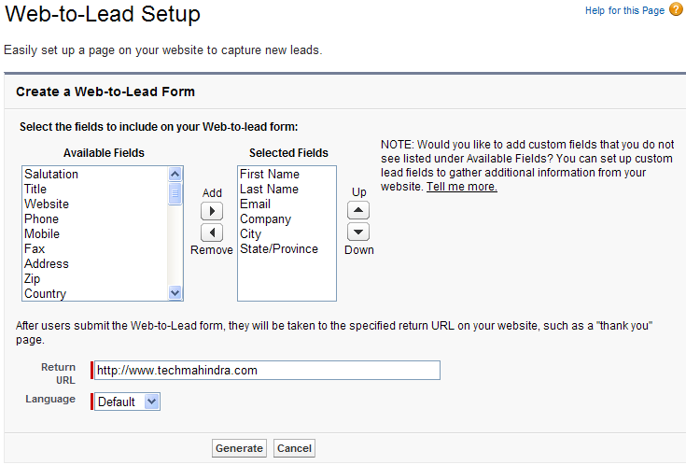
Web to Lead
Web to Lead : Online Form on company website can capture details and automatically generate new leads in salesforce.com

Slide 15
Lead – Advance configuration
We can set up Web-to-Lead Auto-Response rules with conditions that determine which email template to use when responding to leads captured from your website
To retain the custom fields in Lead records after conversion also, Similar fields must be created in Account, Contacts or Opportunities
Such fields must then be mapped to the corresponding fields in Lead record
To map the Lead fields click on
Setup → Leads → Fields → Map Lead Fields

Slide 16
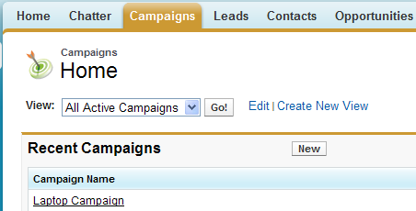
Campaigns
Are the marketing programs
It can be a direct mail program, seminar, print advertisement, email, or other type of marketing initiative
Are used to build awareness about our products / services
Are used to generate Leads
Direct sales efforts to existing clients based on purchased histiry

Slide 17
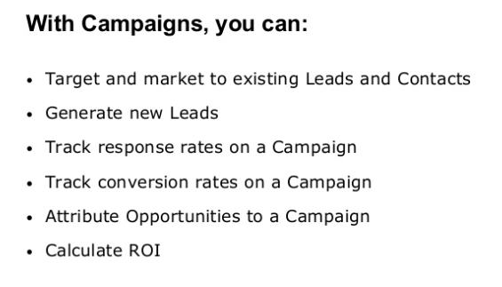
What campaign can do?

Slide 18
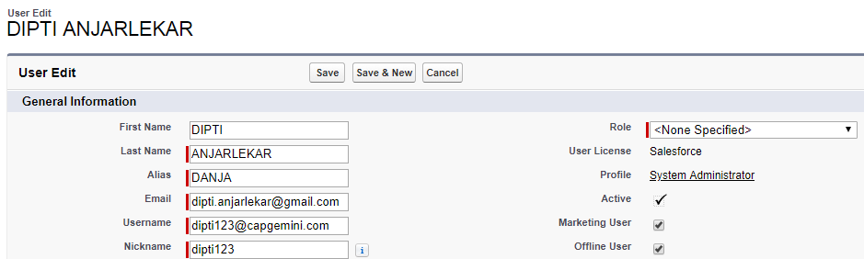
Who has access to campaigns?
Any user in your organization can view campaign, view the adv. campaign setup or run campaign reports
However only designated Marketing user with the appropriate user permission can create, edit, and delete campaign and configure advanced campaign setup
In order to display a list of contacts and leads that are associated to a campaign, you will need to run a "Campaign Call Down Report". This is a canned report located in the Reports tab under the Campaign Reports section.
An administrator must select the Marketing User checkbox on a user’s personal information to designate that user as a Marketing User.

Slide 19
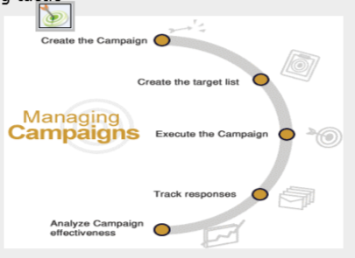
Steps of Salesforce Campaign
1. Campaign Planning
2. Campaign Setup
3. Campaign creation
4. Campaign execution
5. Campaign responses
6. Campaign effectiveness

Slide 20
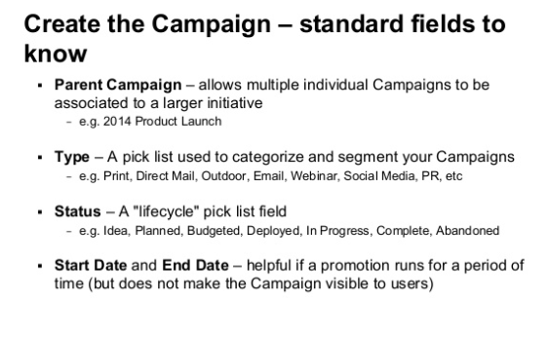

Slide 21
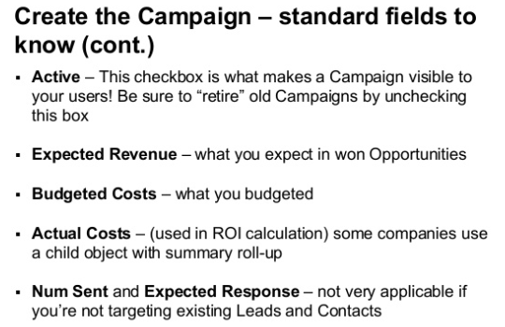

Slide 22
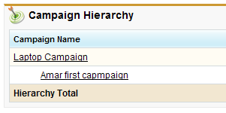
Campaign Hierarchy
A campaign hierarchy allows you to group campaigns together within a specific marketing program or initiative, which enables you to analyze related marketing efforts more efficiently
A hierarchy can contain a maximum of five levels
Each campaign can have only one parent campaign but an unlimited number of sibling campaigns
We can organize campaigns into hierarchies for easy analysis of related marketing tactics
Used to club the campaigns falling under one major Marketing Plan / Initiative

Slide 23
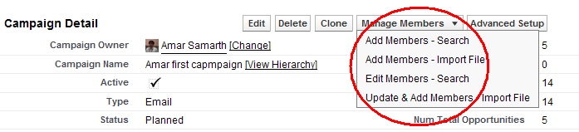
Campaign Member
Campaign members are created from lead, contact, or person account records
On the Campaign Member Detail Page you can view, edit, delete, or clone that record If the campaign Member was created from a lead,
You convert that lead from the campaign member record to a new or existing account, contact, or opportunity.
If the Campaign Member was created from a Contact you can create an opportunity right from the Campaign Member record.
The combination of custom fields, workflow, and triggers for Campaign Member means you can create automated campaigns

Slide 24
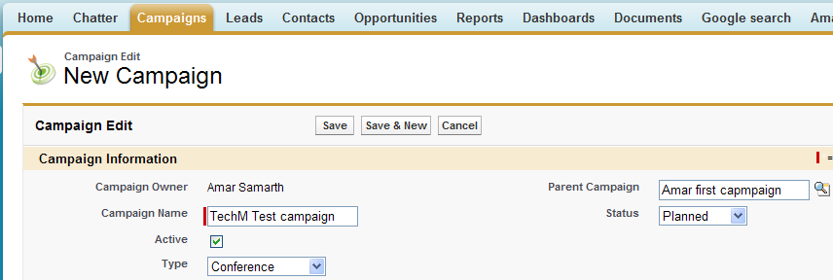
Creating a Campaign
Select Campaign Screen and click on ‘New’ button to create a new campaign
Fill in all required details for this campaign and save the record

Slide 25
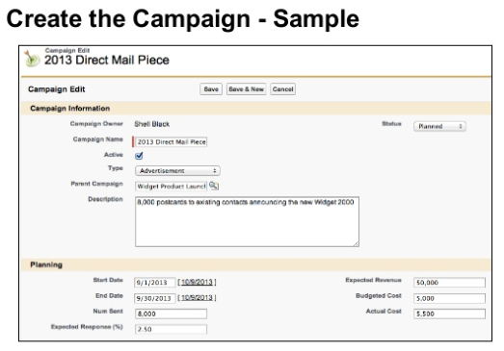

Slide 26
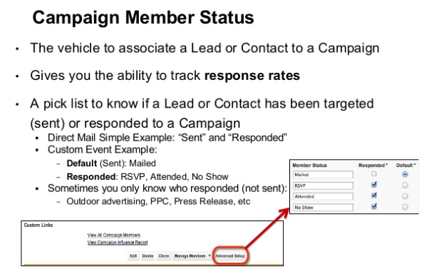

Slide 27
Adding Leads and Contacts to a campaign
Select a campaign to add campaign members to it
Click → Manage Members → Add Members – Search (or other appropriate option)

Slide 28
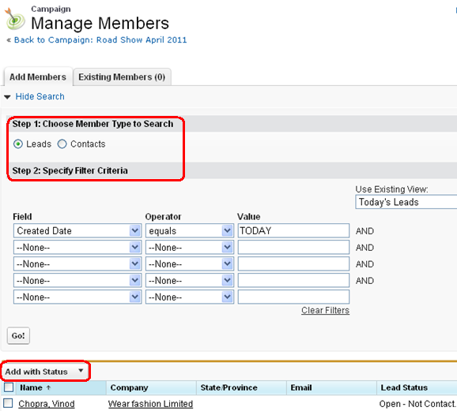
Adding Leads and Contacts to a campaign
Provide the criteria to search the Leads or Contacts
Select the members to be selected for the campaign and Add

Slide 29
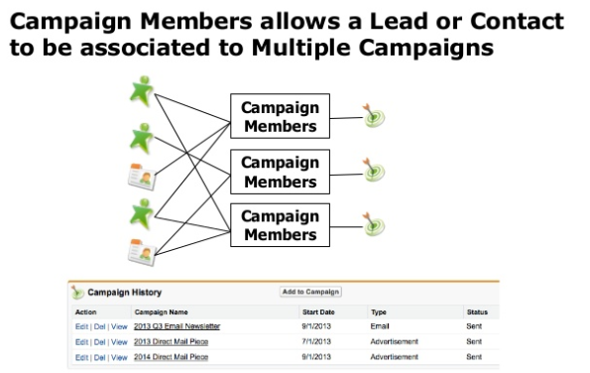

Slide 30
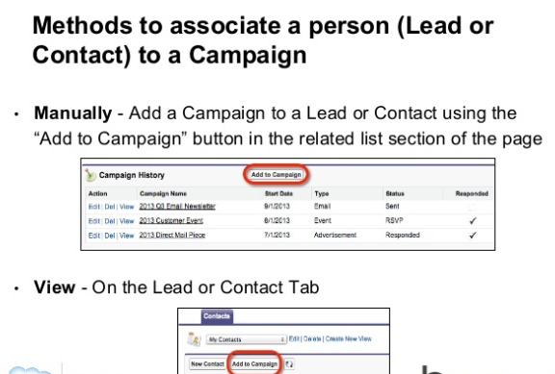

Slide 31
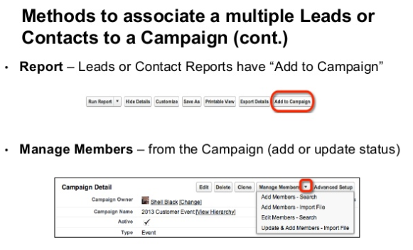

Slide 32
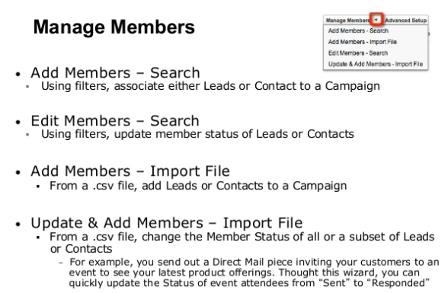

Slide 33
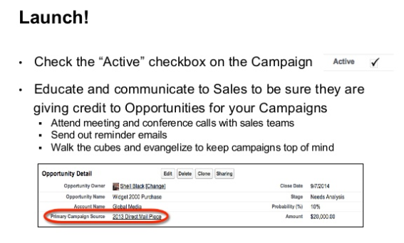

Slide 34
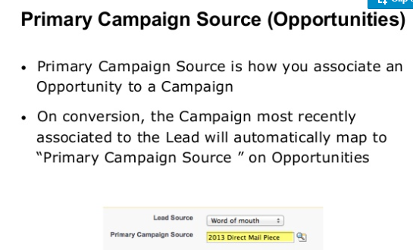

Slide 35
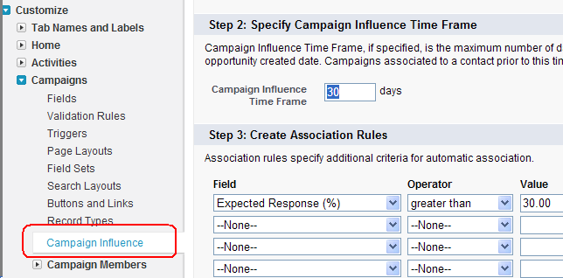
Campaign Influence
Because opportunities are usually influenced by more than one campaign, the campaign influence feature allows you to manually or automatically associate multiple influential campaigns to a single opportunity
Campaign Influence feature allows to track the influence of multiple campaigns on an opportunity
We can use a Campaign member workflow rule to send email to the owner of the leads and contacts, once they are added in a campaign

Slide 36
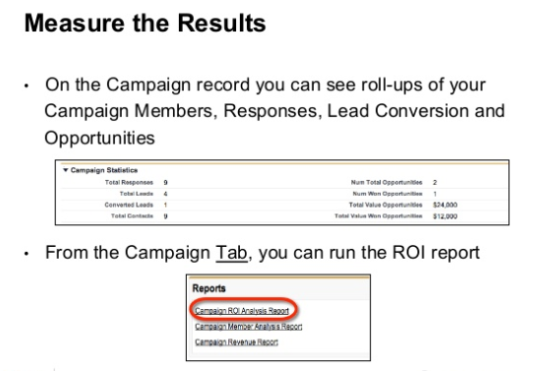

Slide 37
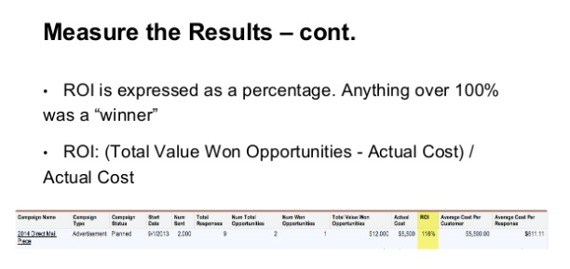

Slide 38
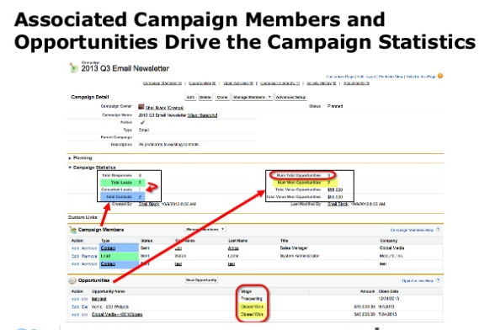

Slide 39
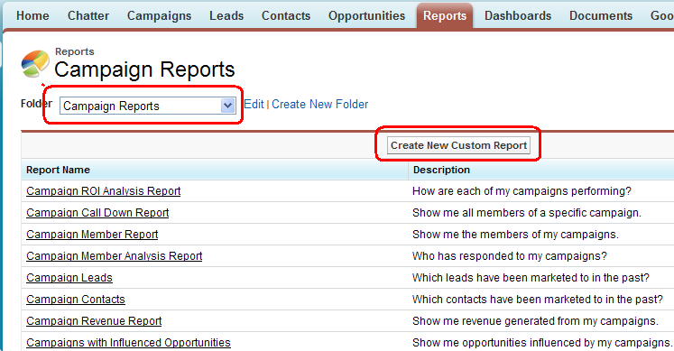
Campaign Reports
Salesforce offers a wide range of standard reports on Campaigns
We can create new custom Reports

Slide 40
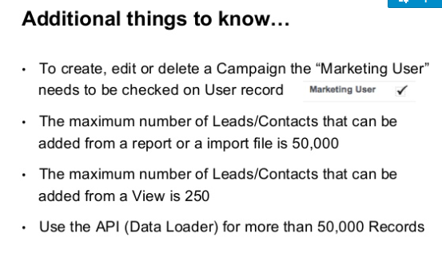

Slide 41
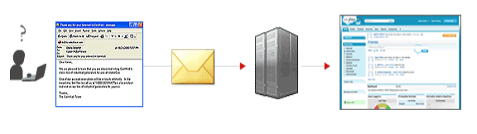
Introducing Email-to-Case
With Salesforce, you can efficiently resolve and correspond with customer inquiries via email.
Track and view all email threads regarding a customer service issue, and let your customers send inquiries to email addresses that automatically convert customer emails to cases.

Slide 42
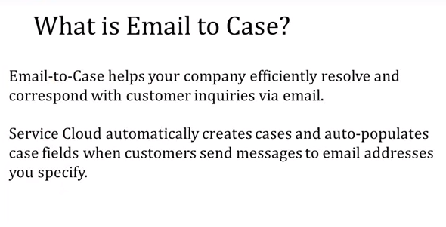

Slide 43
Key Features and Benefits
1. Customer responses regarding a case are automatically associated with the original case, including any attachments the customer sends. 2. Case reporting measures both inbound and outbound emails by case so that you can see how many emails are exchanged before an issue is resolved. 3. Routing addresses allow you to create multiple email addresses from which the contents of customer emails can be converted to case fields. 4. Assignment Rules, Escalation Rules, Workflow Rules and Auto-Response Rules all work seamlessly with Email-to-Case.

Slide 44
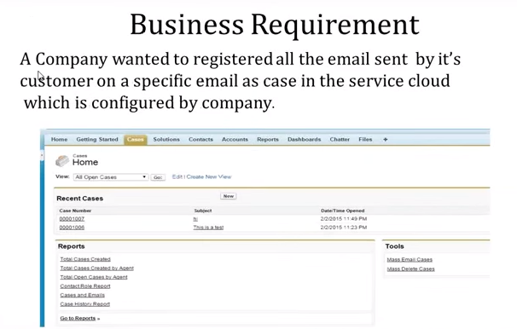

Slide 45
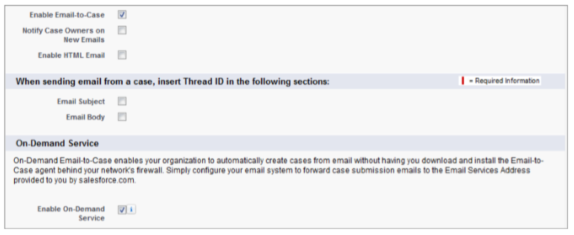
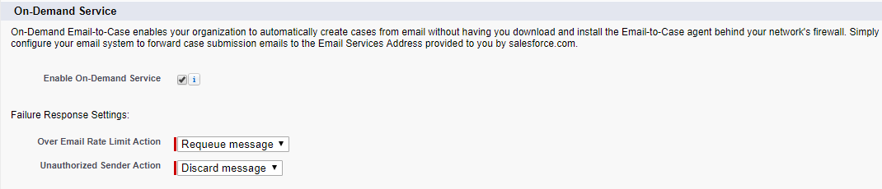
Enable On-Demand Email-to-Case
Click Your Name > Setup > Customize > Cases > Email-to-Case

Slide 46
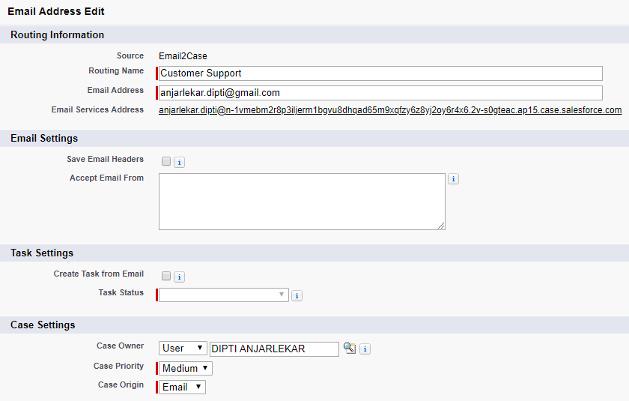
Define and Verify Routing Addresses
Define an email address that will route any emails it receives to Salesforce and converts them to cases

Slide 47
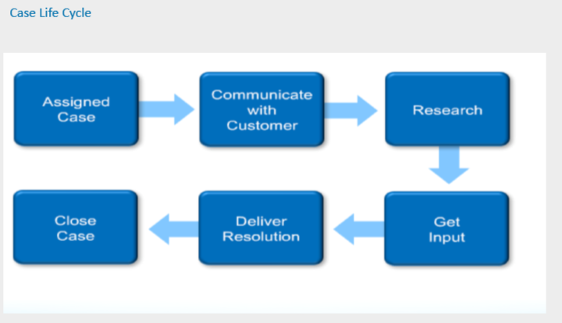
Case Management

Slide 48
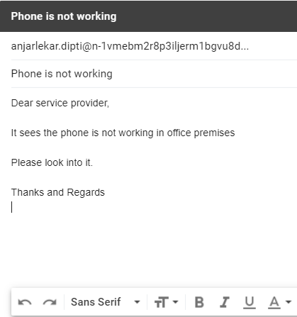
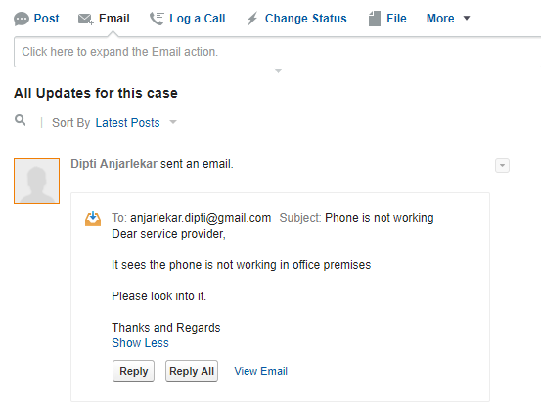
Test What we have done

Slide 49
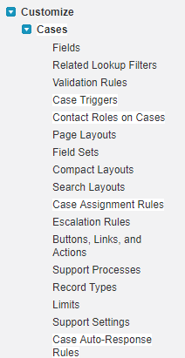
Case Assignment Rules
Automating Case Management
Inquiry cases should automatically go to the right agents
Escalation and Notification should be automated
Automatically assign cases to users or queues based on criteria you define.
You can create multiple rules, but only one rule can be active at a time.

Slide 50
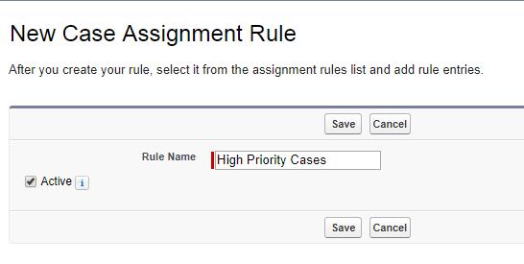
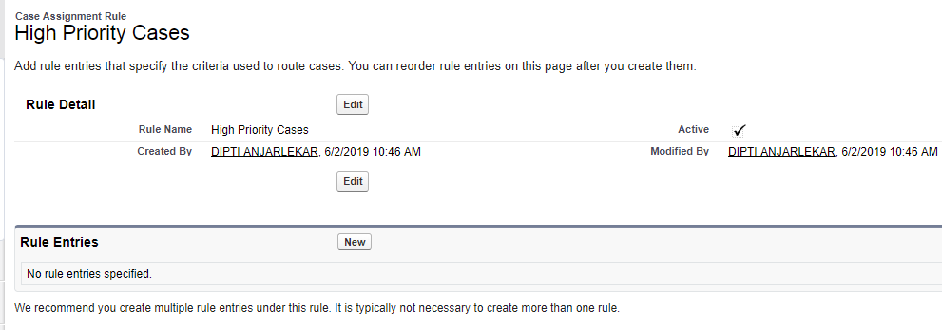
Case Assignment Rules
After you create your rule, select it from the assignment rules list and add rule entries.

Slide 51
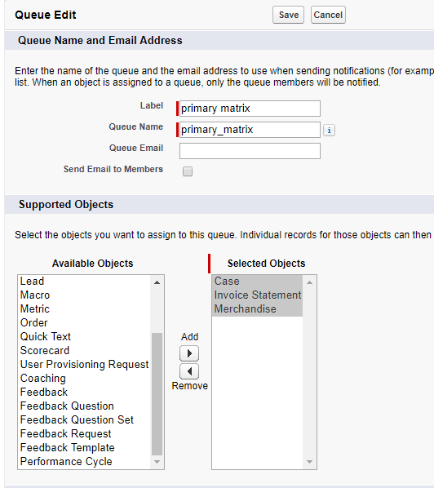
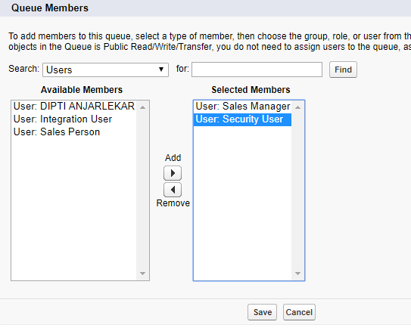
Case Assignment Rules
Create Queue and assign members to it.

Slide 52
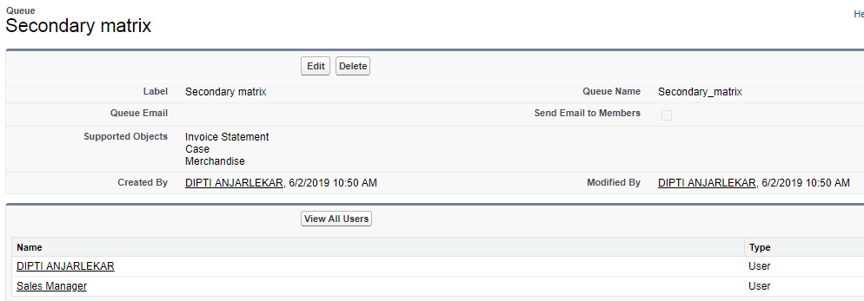
Case Assignment Rules
Create Queue and assign members to it.

Slide 53
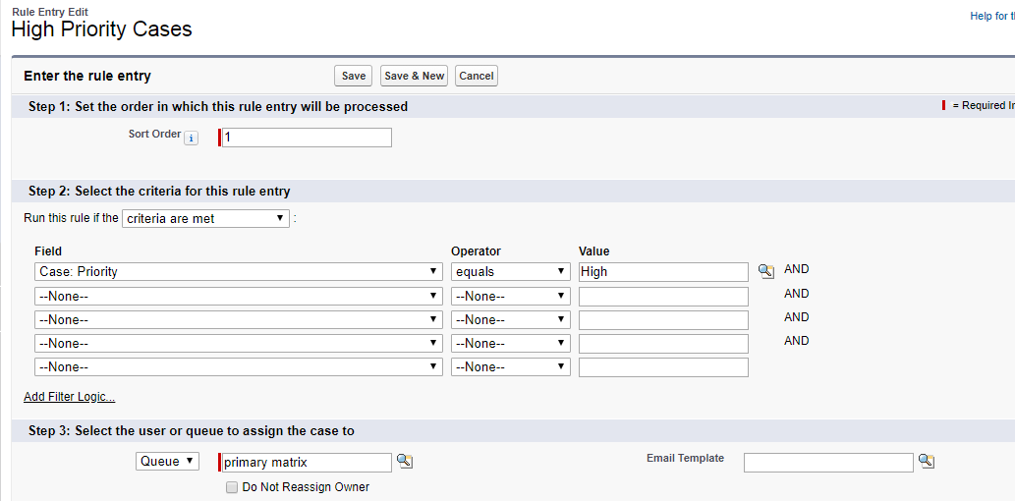
Case Assignment Rules
Case Assignment
‒ Create Assignment rules to route cases to users or queues to work on cases collaboratively or to a support user

Slide 54

Case Assignment Rules
Activate workflow rule button

Slide 55


Case Assignment Rules

Slide 56
Change Sets
Use change sets to send customizations from one Salesforce org to another.
For example, you can create and test a new object in a sandbox org, then send it to your production org using a change set.
Change sets can contain only modifications you can make through the Setup menu.
For example, you can’t use a change set to upload a list of contact records.
Change sets contain information about the org. They don’t contain data, such as records.

Slide 57

Change Sets

Slide 58
Summery
This module showed you how to
Lead management
Campaign management
AutoResponse Rules
Change set

Slide 59
Thank you
Visit us at www.techmahindra.com

